Slide 1
Smart Menu Ordering System
ITI 1Month _ES track final project G2
Supervised By
Eng. Hossam Elzhar Eng. Ahmed Amr

Slide 2
Team Members
Youssef Elbedwehy
Manal Ibrahim
Ahmed Abdallah
Moustafa Sharaf
يوسف البدويهي
منال إبراهيم
أحمد عبد الله
مصطفى شرف

Slide 3
Special Thanks to our hardworking lecturers (Eng. Hossam Elzhar & Eng. Ahmed Amr) for their superior efforts and passion to help us gain these technical skills . We appreciate this to much . Hoping that they lead a life full of success as they deserve

Slide 4
Agenda
Project summery
Primary goals
Drivers
Functions
Protocols

Slide 5
Project Summery
The project consists of two systems connected via UART protocol :
1- Customer which deals with LCD, push buttons to make an order
2- Cashier which is connected to The PC or laptop that takes order number and price

Slide 6
Primary goals
Simulation & Hardware implementation

Slide 7
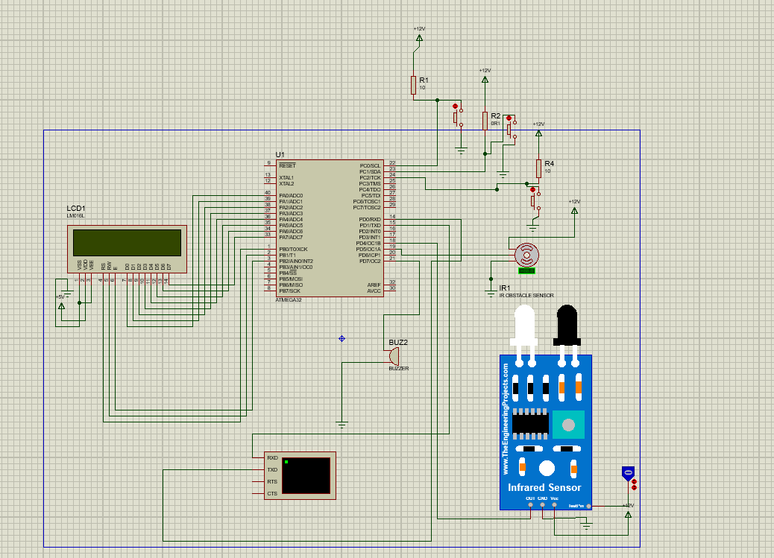
Primary Goals
1- Simulation on Proteus

Slide 8
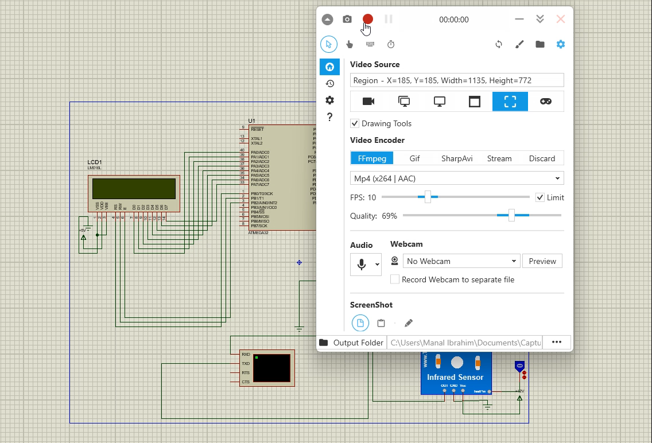
Primary Goals
1- Simulation on Proteus

Slide 9

Primary Goals
2-Hardware Simulation

Slide 10
Drivers
Libraries
BITMATH
STDTYPES
DIO→ MCAL
CLCD→ HAL
UART→MCAL
Timer→ MCAL

Slide 11
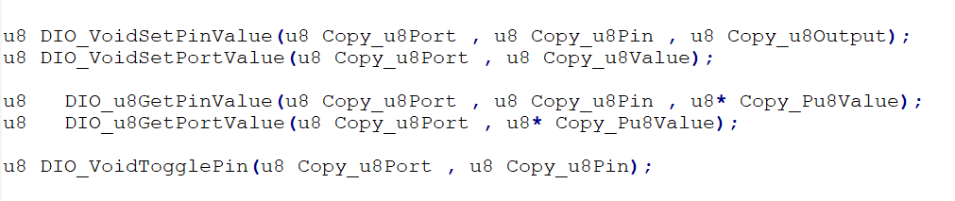
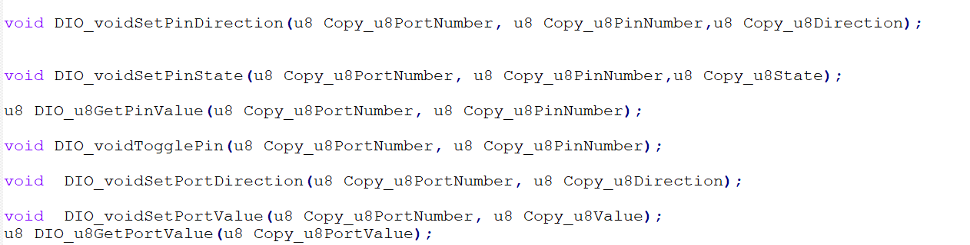
1-DIO
Functions:
in case of 4 files incase of 2 files

Slide 12
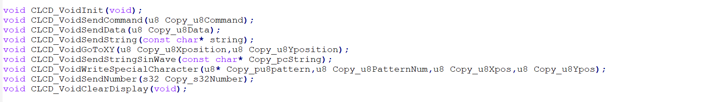
2-CLCD
Functions:

Slide 13
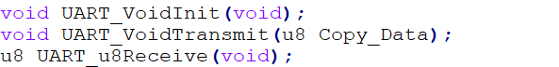
3-UART
Functions:

Slide 14
4-Timer 1
Timer 1 is a 16-bit free-running timer
three independent output compare units, a single input capture unit, and extensive PWM support.

Slide 15
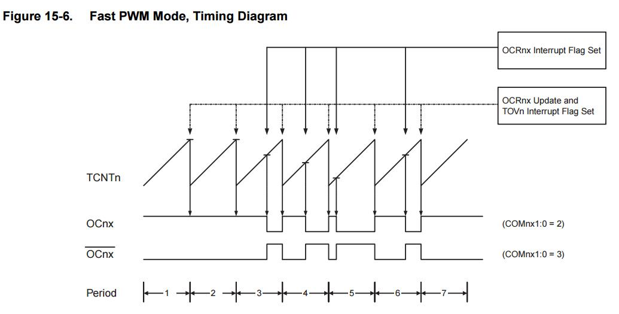
PWM mode
Pwm can be fast mode or phase correct mode
Fast PWM:
The Fast PWM mode is based on single-slope operation.
In single slope operation, the register TCNTn counts from bottom value to maximum value and its value resets to zero.
The counting starts again from bottom. The register OCRn compares the value with the TCNTn register constantly.
Frequency of fast PWM mode signal is twice than Phase Correct PWM mode signal because of its single slope operation.

Slide 16
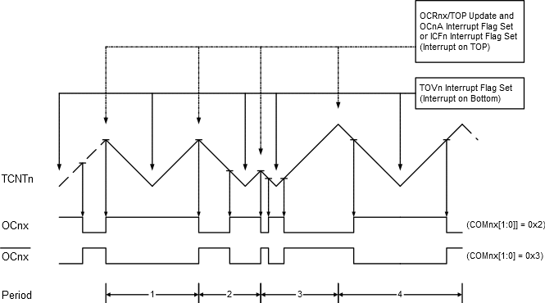
PWM mode
Pwm can be fast mode or phase correct mode
Phase correct PWM:
The Phase Correct Pulse Width Modulation or Phase Correct PWM modes provide a high resolution phase correct PWM waveform generation option.
The Phase Correct PWM mode is, like the phase and frequency correct PWM mode, based on a dual-slope operation.
The counter counts repeatedly from BOTTOM (0x0000) to TOP and then from TOP to BOTTOM.

Slide 17
PWM calculations
Over flow time = 2^ no.of bits * (prescaler / system clock)
Timer clock = system clock/prescaller
Tick time = 1/ timer clock
Timer 1
Overflow time = 20 ms
Ontime= 1ms

Slide 18
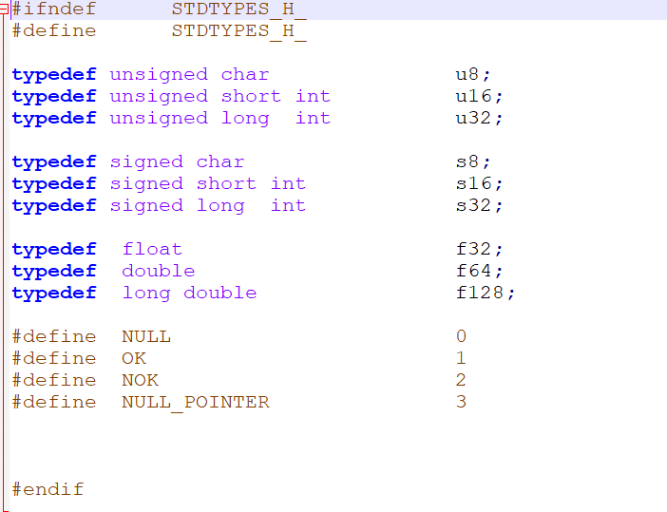
Libraries 1- STDTYPES

Slide 19
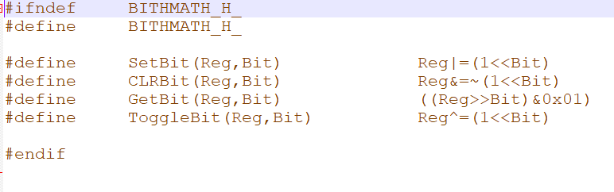
Libraries 2- BITMATH

Slide 20
Functions

Slide 21
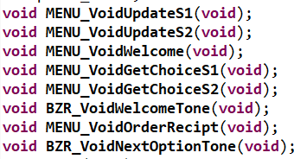

Functions
Let’s go to eclipse

Slide 22

Protocol

Slide 23
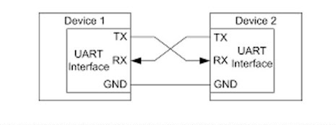
UART
Universal Asynchronous Receiver-Transmitter
Specifications
1- serial
2- wired
3- Asynchronous
4- Full duplex
5- peer to peer
6-Throughput = (data bit number/ frame size ) % [ min 55% , max 81%]
Hardware interface
Data frame format
1- idle
2- start
3-data
4- parity ( check [even or odd])
5- stop (2 or 1)
6- data rate (bps,Bps,fps,buadps)

Slide 24
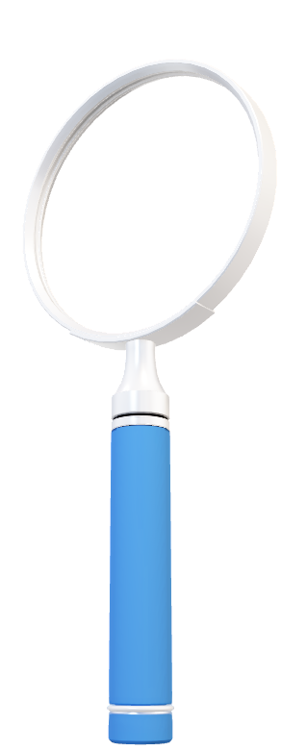
What is meant by US ART ?

Slide 25

Thank you

